Slide 1
Micro Services Approach & Case Studies

Slide 2

Table of Content
Micro Service Approach
Case Studies

Slide 3
Application Modernization Approach ( Monolithic to Micro Service)
Get Master Servlet
Get Controllers
Get Virtual Paths
Extract Call Traces
Asses Methods
Parameterize Sub Flows
Assessment of Sub Sequence &
Alternative Scenarios
Assessment of Persistence
& Caching Model
Get Method Details
List Associated Entities
Identity Persistence Technology
Generate Persistence Model
Green Field Approach
Get Parameter Response
Get Object Size
Get Attribute Count
List down Object Hierarchy
Retrieve Hierarchy Names
Redefine Micro Services
Generate Configuration for
Integration Layer
Get Method Details
Retrieve list of integration components
Read associate configuration details
Generate Configuration
Assessing Parameters for
Each Micro Services
Get Method Details
Get Session Reference
Get Parameter Reference
Re-Group Parameters
Re-Define Parameters
Session Affirmation, Request
Object Référence
Vulnerability Assessment &
Protection
Get Method Details
Asses potential vulnerabilities
Add Filters & Interceptors
Get Method Details
Identity Transactional Methods
Mark Transaction Demarcation
Implement Transaction Model
Re-defining Transactional
Boundaries
Define Strategy for Containerization
& Deploy Service
Get Method Details
List Associated Entities
Identity Persistence Technology
Generate Persistence Model
Copyright © 2016 HCL Technologies Limited | www.hcltech.com

Slide 4



Container Orchestration Engines – Core of Containerization
Engines
Google CaaS Engine
High Availability Clusters
Life Cycle Management
Container Scheduling
Kubernetes
Supported by Variety of Cloud Vendors
PODS Support
Pool Containers
Supports Auto Scaling
Supports to Max. 1000 Containers
Recover Failed Containers
Scale Applications
High Availability
Docker Native Container Engine
High Availability – Multiple Masters
Monitor Resiliency
Leverages Docker Composer
Network Security Using TLS
Verify Runtime Statistics
Health Checks
Docker Swarm
Auto Healing of Clusters
Manual Load Balancers ( Ingress )
Life Cycle Management
Service Discovery
Overlay Networks with DNS
Connects with External Load Balancers
Cluster Load Balancing
Load Balancing
Add External Storage
Multiple Masters with Zoo Keeper
Provisions to Host Other COEs
Apache Mesos
Flexibility to Choose Variety of COEs
Scales to Tens of Thousands of Nodes
Aspects
Copyright © 2016 HCL Technologies Limited | www.hcltech.com

Slide 5
Micro Services Reference Architecture
Configuration Management
CONSUMER CHANNELS
Resilience & Fault Tolerance
Web
Mobile
PoS
SaaS Applications
Business Partners
Social Media
Config Server
Netflix Archaius
Kubertenes Config Map
Consul
Netflix Hystrix
Turbine & Ribbon
Kubertenes Health Check
Resource Initiation
Multi-pattern: Request / Reply, Fire & Forget, Call back, Streaming
Multi-protocol: REST XML, REST JSON, SOAP, OAuth 2.0, SAML
API Gateway
Spring Zuul
Kubertenes Service
Ingress Resources
Service Security
Auto Scaling & Self Healing
Spring Cloud Security
Kubertenes Health Check
Self Healing
Auto Scaling
Load Balancing
Netflix Ribbon
Kubertenes Service
Centralized Logging
ELK Stack
ELF Stack
Service Discovery
Job Management
Netflix Eureka
Hashicorp Consul
Kubertenes Service
Ingress Resources
Spring Batch
Kubertenes Job
Scheduled Jobs
Centralized Metrics
Build & Deploy
Netflix Spectator
Atlas
Heapster
Prometheus
Grafana
Spring Boot
Docker/Rocket
Spring Kubertenes Scheduler Boot
Azure Service Fabric
AWS Lambda
Singleton Application
Spring Cloud Cluster
Kubertenes Job
Kubertenes PODs
Docker Swarm
Kubernetes
Apache Mesos
Distributed Tracing
Container Orchestration
Spring Cloud Sleuth
Zipkin
Open Tracing
Zipkin
Internal Integration
Request/Reply, Pub/Sub, Fire & Forget, Call Back, P2P, ETL/ELT, Batch, File Integration, EDA, etc
Transaction Management
ENTERPRISE SYSTEMS
Kafka
ERP
CRM
Content Management
Enterprise Data
Legacy Systems
Copyright © 2016 HCL Technologies Limited | www.hcltech.com

Slide 6


Micro services Migration – Service Extraction Process
REST
REST
Module A
Module B
Module A
Module B
Module A
Module C
Module C
Module C
Module B
Blue Green Deployment Model
REST
REST
DB Adapter
DB Adapter
DB Adapter
DB Adapter
DB
DB
DB
DB
Extract Modules that change frequently
Modules with Significant Resource Requirement
Select Modules based on Technology Choices
Pick up services those are Computational Intensive
Prioritize modules those needs particular resource requirements
Look for Existing Coarse Grained Boundaries
Define Coarse Grained Interface between modules and Monolithic
Establish IPC Mechanism
Copyright © 2016 HCL Technologies Limited | www.hcltech.com

Slide 7
Micro services Migration – Extensibility & Maintainability
HTTP Request
Request Router
Web Application
Web Application
Web API
Web API
REST
Blue Green Deployment Model
Monolithic
Service
Business Logic
Business Logic
REST
DB Adapter
DB Adapter
DB Adapter
DB Adapter
DB
DB
DB
DB
Do not add new code to monolithic
Put new code in the standalone micro services
Create glue to integrate new micro services with monolithic
Separate business logic out of presentation layer
Convert Presentation as Micro Services
Create Glue to consume micro services from presentation layer
Copyright © 2016 HCL Technologies Limited | www.hcltech.com

Slide 8
Domain Driven Design – Process & Packaging
Bounded Context
Bounded Context
Deployment Unit
Sub Domain
Sub Domain
Aggregates
Data Store
Persist
Synchronize
Replicate
Domain Model
Infrastructure Layer
Shared Kernel
Layout
Events
Consume
Event Store
Domain Store
Client Layer
UI Layer
Generic Sub Domain
Bounded Context
App. Layer
Facade
Invoke
Mediate
Consolidate
Aggregates
Aggregates
Domain Layer
Respond
Domain Model
Domain Model
Domain Model
Business Logic
Domain Event
Event Store
Event Store
Domain Event
Construct
Copyright © 2016 HCL Technologies Limited | www.hcltech.com

Slide 9
Micro services Architecture Maturity Model
Platform
Agile
Clients Use Alternate Strategy when Services Fail
Large Shared Data is Sharded
Adaptable Systems
Comprehensible
Failures are Localized
Logging to a Centralized
Logging Service
Cohesive
Composable /
Orchestrated
Auto-Scaling Aware
Load Balancer
Instances are Fungible
Designing Services
Organized by
Business Capability
Reactive
Stateless
Modular
Independently
Deployable
Quick Deploy & Rollback
Fast Start Startup
and Shut down
Foundation is
Established
Polyglot Programming
Automated Testing
Horizontally Scalable
Speed of
Innovation
Safety
Scale
Copyright © 2016 HCL Technologies Limited | www.hcltech.com

Slide 10


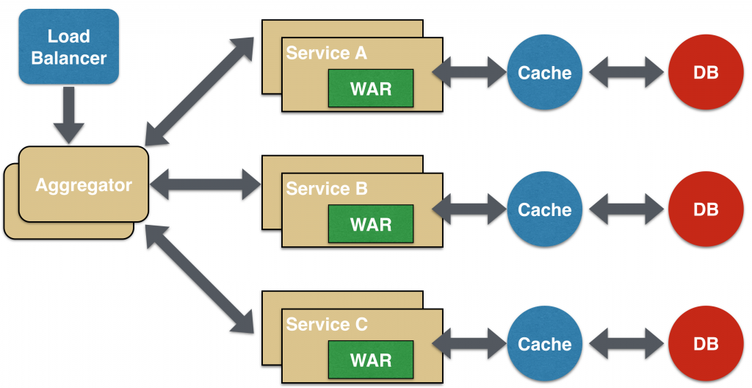
Micro services Patterns & Principles
Microservices Pattern & Characteristics
Architecture pattern where complex applications are composed of small, independent processes and services, each organized around individual business capabilities.
Services are small and focused
Microservices have language-agnostic application program interfaces or APIs.
Decentralized Governance - Enables developer choice to build using preferred languages
Single Business Capability
Focus on Reusability
Adopt Evolutionary Design
Microservices Design Considerations
Service Structure Patterns:
Simple Inquiry/Update
Composite Inquiry - Data Aggregation from multiple data sources
Composite Update - Data updates to multiple data sources with / without orchestration
Business Rules Engine - Using an internally hosted rules engine
Reusable Frameworks & Components for:
Error/Exception Logging
Generating service documentation (generate Swagger specs - in case of RESTful Microservices)
Cache
Microservices
Copyright © 2016 HCL Technologies Limited | www.hcltech.com
Notes:
(This needs a better use case for microservices as components)
Microservice is an architecture pattern where complex applications are composed from small independent processes and services, each organized around individual business capabilities.
Microservices are small and focuses.
Microservices have language-agnostic APIs. REST APIs are particularly common.
Microservices have decentralized governance. This allows developers to use the technologies that they prefer.
Microservices design considerations include:
Focus on a single business capability Each microservice should have operation that are related to only a single business capability. For example, a price lookup product service, should not include catalog browsing operations to provide information to help a customer select a product. Nor should it include inventory operations to find out how many of the product are on hand.
Microservices should be designed with reusability in mind. It should be possible for multiple applications to share a microservice. Whether applications share a separate instance of a microservice is a separate consideration.
The design and implementation of microservices often follows an evolutionary pattern. This is possible because it is possible to deploy microservices independently of each other and independently of their clients. The initial implementation of a microservice can simply be something that returns a few hard-coded results. After that the architecture and implementation of the microservice can evolve iteratively into a fully functioning version of the microservice.
The diagram in the lower left shows how microservices might be deployed in a distributed cloud-based application. This deployment consists of:
Three microservices labeled A, B and C.
A load balancer, which is needed if there are multiple instances of the microservices. Otherwise there is no need for a load balancer.
An aggregator or orchestrator that handles composite operations that require the user of multiple microservices.
A database. The microservices may share a database or not.
A cache for data from the database. Instances of the same microservice may have their own separate cache. Instances of the same microservice may also share a distributed cache.
This architecture can support a few use patterns:
Simple inquiry/update This is the simplest case where an inquiry or update involves only a single microservice.
Composite Inquiry This is an inquiry that involves multiple microservices and requires the aggregator to combine or aggregate results from the multiple microservices.
Composite update This is an update operation that involves multiple microservices. For example canceling an order for goods may involve an order management microservice and an inventory management microservice. Update operations ofter require orchestration of multiple microservices. In simple cases the orchestration is hard wired into the aggregator. In other cases a workflow engine might be integrated into the aggregator.
Business Rules Engines Complex orchestration is usually does with the help of a business rules engine.
The different parts of the microservice deployment are built using common or off-the-shelf frameworks and components:
Error / Exception logging is done with a library such as logback or log4j. If microservices are being run in a cloud environment, you may want to use a centralized log server such as logstash, graylog2 or splunk.
For application developers to write code that uses a microservice, they will need documentation for the microservice. For RESTful microservices, Swagger is a good for generating documentation.
For in-memory caching, Google’s Guava library includes good support. For caching data to disk ehcache is a good choice. For distributed caches, you might also consider Hazelcast.
Microservice frameworks include spring boot, dropwizard and akka.

Slide 11
Micro Services Behind API Gateway
Drawbacks of Microservices
Application Clients/app developers need to understand how the application is partitioned into micro services
Microservices typically provide fine-grained APIs, which means that clients need to interact with multiple services to get the desired data
Different clients need different data. For example, the desktop browser version of a product details page on desktop is typically more elaborate then the mobile version.
Benefits of using an API gateway:
Abstracts details of how the application is partitioned into micro services from client applications.
Clients are insulated from determining the locations of service instances
Secures the services(backend) from client attacks
Provides the optimal API for each client (desktop, mobile etc.)
Reduces the number of requests/roundtrips by moving logic for calling multiple services from the client to API gateway.
Single entry point
Traditional
Web Application
Service A
API
Gateway
Service B
Browser/
Native App
Service C
Client-specific
APIs
Protocol
Translation
Copyright © 2016 HCL Technologies Limited | www.hcltech.com
Notes:
A drawback of microservices is that developers need to understand how apps are partitioned into microservices. An API gateway is a façade service that provides all of the services the app needs in one place. The application gateway implements the operations by forwarding them to the appropriate microservice. If multiple applications share microservices, they may not share the same API gateway. Another benefit of this arrangement is that applications don’t need to know the address of the microservices.
Because microservices provide fine grained APIs, the interactions between applications and microservices may be more complex for the applications than is ideal. An API gateway can provide an API that is tailored to the needs of the application.
Due to the business capability focus of microservices, including security features in Microservices is not always a natural fit. An API gateway can provide a layer of security between the services and applications.
API gateway can be implemented on top of frameworks like Apache Camel, JBOSS FUSE or NGINX for routing and load balancing.

Slide 12
Cast Study
Allianz Insurance
Disney
Cathay United Bank
Volvo Motors
T-Mobile
Copyright © 2016 HCL Technologies Limited | www.hcltech.com

Slide 13
Case Study #1 – Allianz – Smart Home Cover
Client : Largest Insurance Company
Business Objectives
HCL Solution
Design the angular based UI that can be accessed through
Multiple customer channels – Agent,Customer,SB,Allianz Online
Multiple devices – Tablets, laptops, desktops
Platform available to partner channels with proper controls and security in place
Ability to accelerate time to market and other apps to enable marketplace innovation
Allianz Online built with common UI components and templates prebuilt as per UX guidelines
Iterative development and loose coupling between UI and Backend APIs, resulting in fast mockups of UI, and parallel development on APIs
Tools/Technology Used
Customer Benefits
Swagger, JSON
OAUTH 2.0
Maven, Jenkins (deployment automation)
APIGEE API Platform
HTML5 / CSS3 /ANGULAR JS
Spring Boot,Hibernate,Java 1.7
SQL Server 2000
API platform enabled with continuous integration and continuous delivery
Lightweight micro-services and easy to scale
APIs are extensible, and can evolve with changing needs
Common Services such as Authorization, Security, Error handling, Logging, Mocks and Regression Testing built into the framework.
Highly secured environment against threats, vulnerabilities
Adoption to Existing Allianz Online
Responsive web design using Angular JS
Copyright © 2016 HCL Technologies Limited | www.hcltech.com

Slide 14
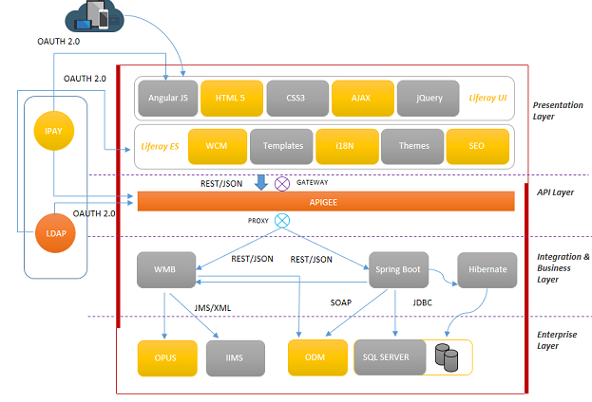
Case Study #1 – Allianz – Smart Home Cover– Solution Architecture
Copyright © 2016 HCL Technologies Limited | www.hcltech.com

Slide 15
Case Study #1 – Allianz – Smart Home Cover, Learning & Best Practices
Deployment
Dev Ops CI/CD for containers
Security
API gateway for policy enablement – Useful especially for microservices exposed to partners/public consumption
Establish Deployment strategy at design time. Baseline application NFRs (response time, throughput etc)
OAUTH enabled security using Tokens
Adhere to OWASP Top 10 Application Security Vulnerabilities
Copyright © 2016 HCL Technologies Limited | www.hcltech.com

Slide 16
Case Study #2 – Disney – Apollo Accounting
Client : Largest Media and Entertainment Company
Business Objectives
HCL Solution
Supply License through online for the dealers
Ability to map customer deals with the deal products.
Increase Data Quality of the consumer Information
Separate features for Golden and diamond customer
Security implementation with cutting edge technologies
Apollo accounting system provides Angular based UI components for dealers search
Spring based micro services developed to deal with deals, Revenue recognition, etc.
Security implementation done with OAuth2
Tools/Technology Used
Customer Benefits
OAUTH 2.0
Maven, Jenkins (deployment automation)
Swagger, JSON
ANGULAR JS
Spring Boot, JDBC Template, Java 1.8
DB2
Micro services enabled with continuous integration and continuous delivery
Common Services such as Security, Error handling, Logging, Mocks were built into the framework.
Highly secured environment against threats, vulnerabilities
Integration with other licencing systems
Interactive UI pages with Angular framework
Copyright © 2016 HCL Technologies Limited | www.hcltech.com

Slide 17
Case Study #2 – Disney, Deployment Architecture: Development Environment

Slide 18
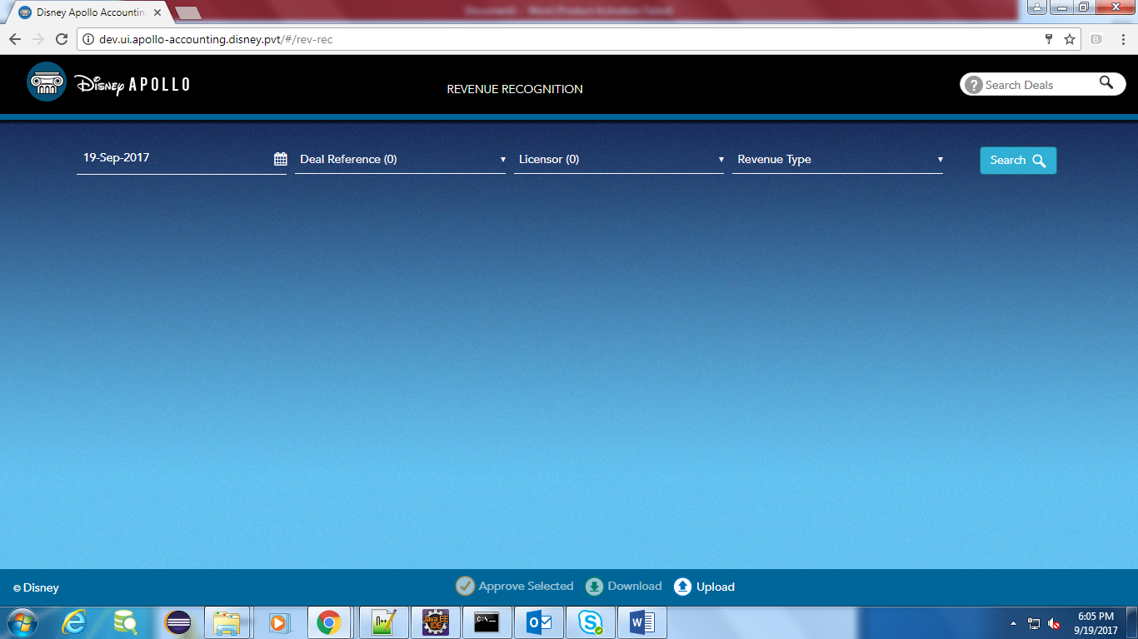
Case Study #2 – Disney, Apollo screen for revenue recognition search

Slide 19
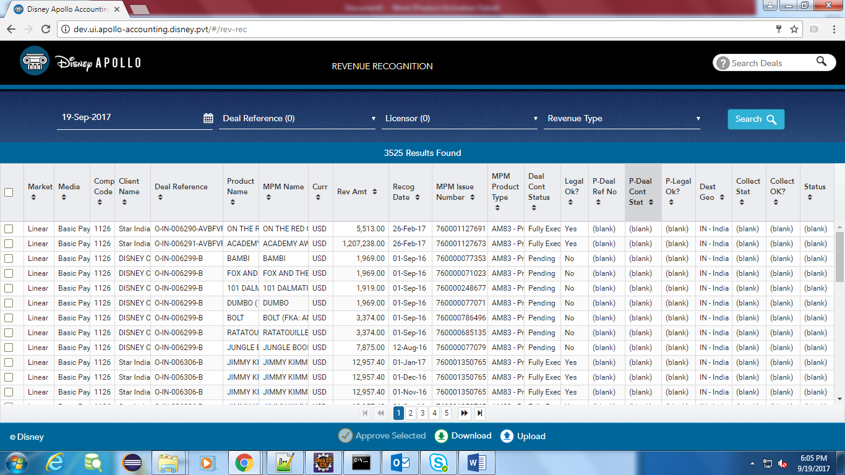
Case Study #2 – Disney, Revenue recognition search results

Slide 20
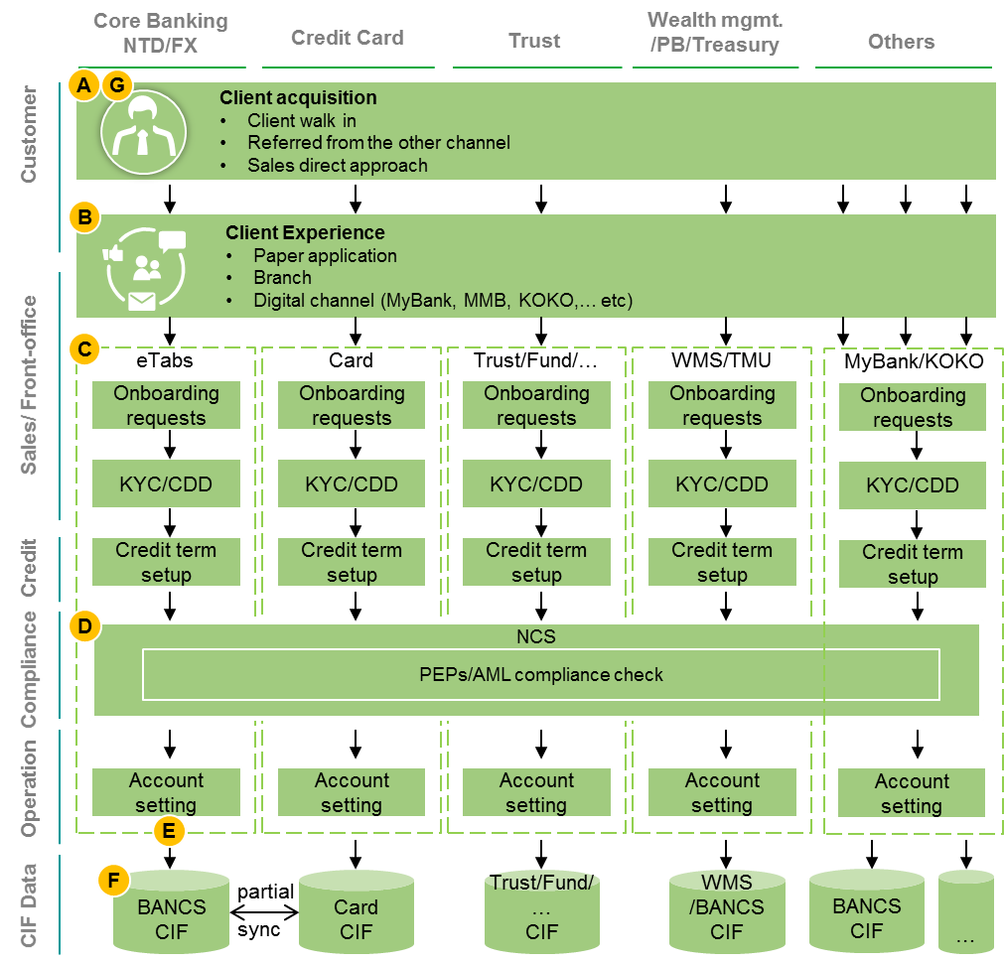
Case Study #3: CUB Current– On boarding / MDM / AML
Challenges
Customer based / risk view
One customer with multiple scores: Scoring is done on the onboarding system. A customer may have different scores due to different information of the onboarding system.
Product/service factor can’t be considered: Since there’s no real time connection between onboarding system and customer information doesn’t come from the data warehousing, we can’t get the customer product/service combination when onboarding scoring.
Data consistency integrity
Customer information inconsistency: Customer data varies from system to system due to the business requirement(also as the Data completeness), data update time or system limitation.
Data completeness
KYC process is different: KYC is different due to different business requirements. Ex: customer are required to give occupation prove for credit card application, but not for saving account, which causes occupation may be different in backend systems for one customer.
Goals
Eliminate inconsistent and distributed master data
Customer Master Data has to be centrally stored, providing a “Single Source of Truth"
and a CUB specific “Global ID”.
Reduce Transaction Volume to Back-ends through TR
High volume of transactions caused by too many inquiries from frontend to backend
Systems via middleware; TR (Middleware) is not able to deal with the volumes
Enable modern analytic capabilities
An integrated view (e.g., 360 degree view) on each customer, its transaction data,
interactions, experiences and attitudes, etc. to facilitate CRM and cross-selling opportunities
Omni channel experience
Copyright © 2016 HCL Technologies Limited | www.hcltech.com

Slide 21
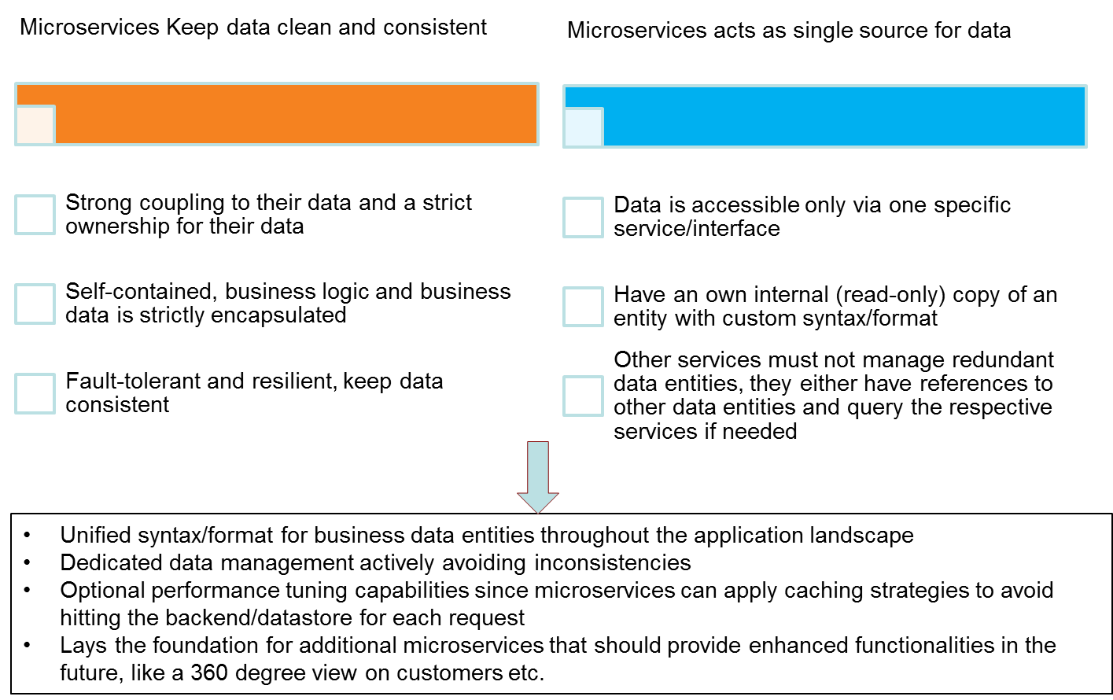
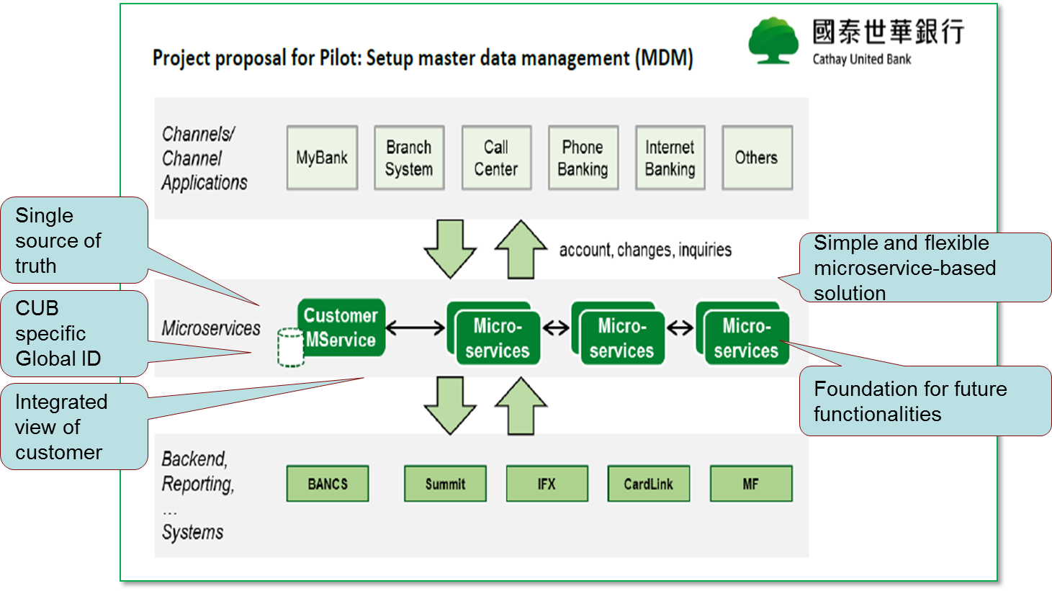
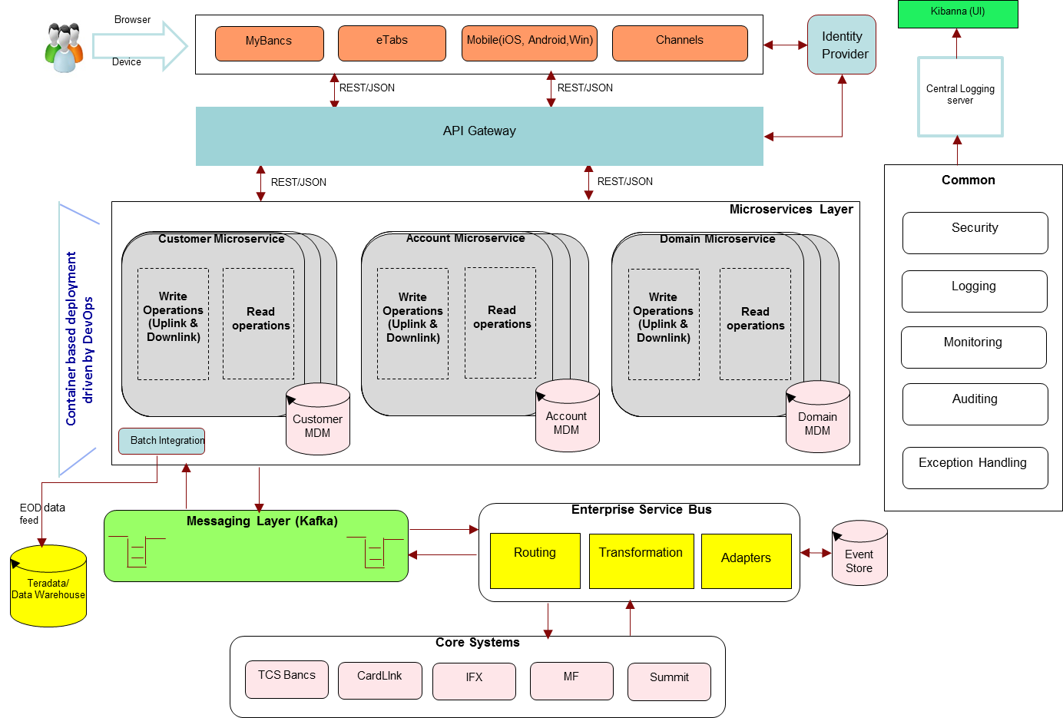
Case Study #3: CUB Current MDM – Micro Services Based Solution
Copyright © 2016 HCL Technologies Limited | www.hcltech.com

Slide 22
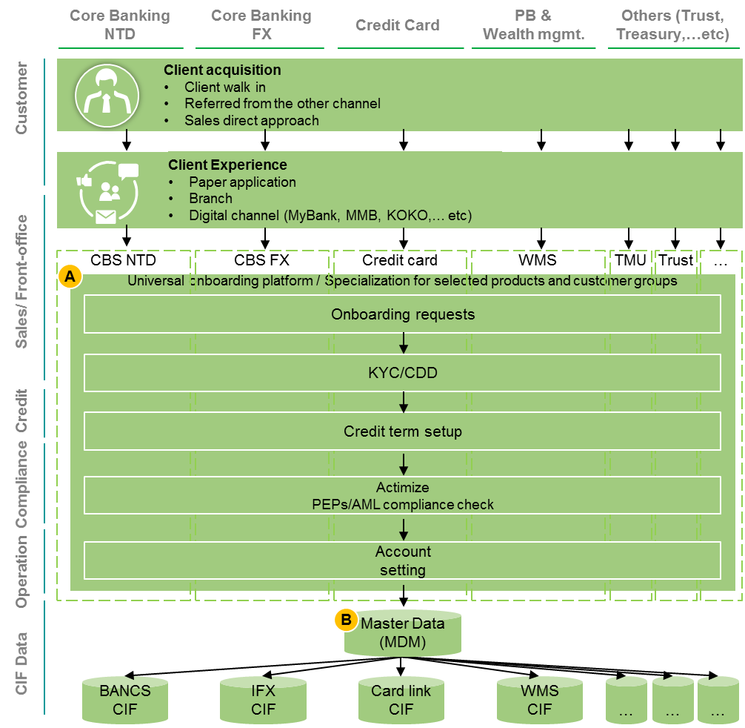
Case Study #3: CUB Target Architecture - On boarding / MDM / AML
Design the universal onboarding platform for Omni channel
MDM should be the master data and synchronize to each core systems
Copyright © 2016 HCL Technologies Limited | www.hcltech.com

Slide 23
Case Study #3: CUB Tools & Technologies
Microservices Environment
DevOps Environment
S.# | Software | Comments
1 | OS – Red Hat Linux (v7.2)
2 | F5 | Load balancer
3 | Spring Cloud, Spring Boot with Tomcat | Microservices’ Runtime environment
4 | Spring Integration | Integration layer
5 | KAFKA | Messaging layer
6 | PostgreSQL | Database
7 | ELK | Centralised Logging server
S.# | Tool | Purpose
1 | Atlassian BitBucket (GIT) | Version Control System
2 | Jenkins | Continuous Integration tool
3 | Maven | Build tool
4 | Sonarqube | Static Code Analysis
5 | Artifactory | Binary Repository
6 | Atlassian JIRA | ALM tool
7 | Docker | Docker images
8 | SoapUI | Integration Testing
9 | ELK (Elastic Search, Logstash, Kibana) | Logging and Monitoring
Copyright © 2016 HCL Technologies Limited | www.hcltech.com

Slide 24
Case Study #4: Volvo - Azure Retail Integration Platform
Client : Largest Automobile Manufacturer of Sweden
Business Objectives
HCL Solution
One Consumer Profile across all dealers
Clear Understanding of Consumer Behavior & Needs
Ability to communicate based on Consumer Preference & Insights
Increase Data Quality of the consumer Information
Full Transparency of Activities across the consumer life cycle
Flexibility in integrating with Multiple Sources of Data
Centralized Access Control & Threat Protection
HCL implemented the API layer to expose the e-commerce middleware layer services for digital channels
The solution also catered to multiple geographies
Information tracking and end-to-end services management enabled at every stage across all services provided by the solution resulting in better end user experience
Centrally hosted consumer data base for store & retrieval process to avoid latency
Azure iPAAS Implementation for flow orchestration
Tools/Technology Used
Customer Benefits
Azure Public Cloud, Service Fabric, Cosmos DB
Swagger, JSON
OAUTH 2.0
Azure Active Directory
Azure Service Bus, Azure Policies
Maven, Jenkins (deployment automation)
.NET Web Services, Azure Document DB
The solution laid the foundations for an API framework that is now extendable to other markets
Centralized access for consumer profile & opportunities among dealers across regions
Highly secured environment against threats, vulnerabilities
Globally accessible and centrally controlled solution leveraging azure public cloud
Easy to Notify, Monitor & Monetize API access by dealer systems
Pluggable & Dynamic Integration Architecture using Azure Logic APPs
Copyright © 2016 HCL Technologies Limited | www.hcltech.com

Slide 25
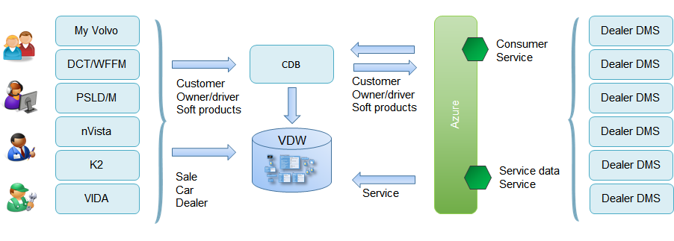
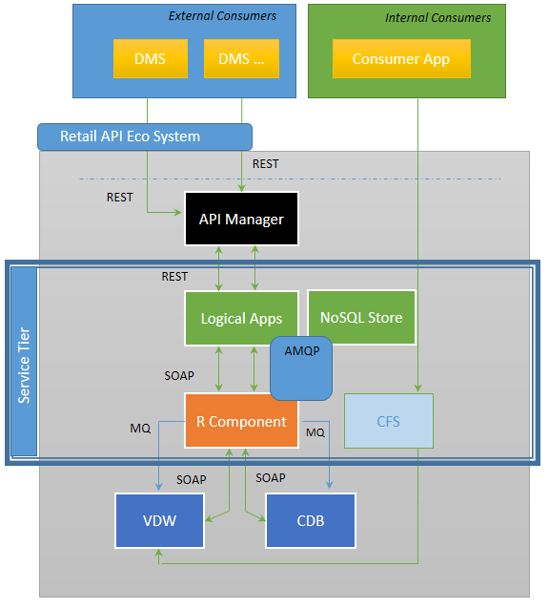
Case Study #4: Volvo Retail Integration Platform – Solution Architecture
GRIP – Partner Eco System
GRIP - Solution Architecture
Copyright © 2016 HCL Technologies Limited | www.hcltech.com

Slide 26
Case Study #5: Retail Platform Modernization for T-Mobile
Client : One of the largest Wireless Service Provider with 38,000 employees servicing 46.7 million customer and $41BN in Revenue
Business Objectives
HCL Solution
Create a modern web platform that can be accessed through
Multiple customer channels - retail, call center, online
Multiple devices – Tablets, laptops, desktops
Platform available to partner channels with proper controls and security in place
Ability to accelerate time to market for travel money card app and other apps to enable marketplace innovation
App Platform built with common UI components and templates prebuilt as per UX guidelines
Iterative development and loose coupling between UI and Backend APIs, resulting in fast mockups of UI, and parallel development on APIs
Tools/Technology Used
Customer Benefits
APIGEE API Platform
HTML5 / CSS3 / JS
CSS Visual Libraries
Swagger, JSON
OAuth
API platform enabled with continuous integration and continuous delivery
Created Channel specific lightweight micro-services
APIs are extensible, and can evolve with changing needs
Common Services such as Authorization, Security, Error handling, Logging, Mocks and Regression Testing built into the framework.
Copyright © 2016 HCL Technologies Limited | www.hcltech.com

Slide 27



Case Study #5: Retail Platform Modernization for T-Mobile
App Layer | API Layer (Aggregation and Delivery) | ESB | Business Layer
User Channels
Apigee Edge API Platform
Business Services
OneUI
Presentation
Services
Customer
Browser
Apigee – API Proxy (Façade)
Information Services
RESTful APIs
Backend Delegate
Data Services
Tablet
● Routing ● Mediation
Retail
● Transformation
● Orchestration
Component Services
Caching
Security
Analytics
DB
Mobile
Legacy Services
Call Center
HTML5 / CSS3 / JS
CSS Visual Libraries
Process Services
RESTful APIs
RESTful APIs
CMS
Cloud
Shared API Services
Security
Permissions
i18n / Localization
Validation
Error Handling
Logging
Mock APIs
Regression Framework
To meet the enterprise wide, Omni –channel B2C and B2B partner connectivity needs. in process to move the APIs to a commercial platform.
Platform is cloud ready.
Copyright © 2016 HCL Technologies Limited | www.hcltech.com

Slide 28
Case Study #5: T-Mobile, Learning & Best Practices
Architectural Principles
Establish architectural principles
Key principles are data and decoupling of dependencies
Domain Identification
Business level domains to be determined
Next level business domains to be arrived at, if needed. Microservice Granularity (Service vs. Operation)
Data
Distributed transaction issues need to be watched out for
Separate Read Write repositories for efficient reads. E.g. NoSQL for Reads and SQL for Writes and a data sync mechanism
Copyright © 2016 HCL Technologies Limited | www.hcltech.com

Slide 29
Case Study #5: T-Mobile, Learning & Best Practices
Deployment
Dev Ops CI/CD for containers
Security
OAUTH enabled security using Tokens
API gateway for policy enablement – Useful especially for microservices exposed to partners/public consumption
Common Utilities
Logging as event streams – Centralized Logging Store
Auditing as Microservice
Error Handling could vary for each micro service depending on the business context and the criticality.
For aggregator services spanning multiple microservices, Compensation strategy and/or Retry mechanism needs to be appropriately decided.
Governance
Registry – Registration, Discovery and Consumption of microservices. May not be an immediate priority but important as the number of microservices increase.
Versioning of services – Similar versioning strategies as applicable to SOA Services.
Establish Deployment strategy at design time. Baseline application NFRs (response time, throughput etc)
Copyright © 2016 HCL Technologies Limited | www.hcltech.com

